Slide 1
RENDERING
REAL-TIME
Brief Introduction
A presentation of Intro to Computer Science
鲁劲帆
任雨奇
李天宇
Notes:
Hello everyone, today we want to share our group work about real-time rendering in computer graphics. Since we have a lot to share, we assume you have enough basic knowledge.

Slide 2
The Reasons
1
Make some amazing games
Need better Quality and Fluency
E.g., excellent gaming technology and higher FPS
PART
Have better understanding of Computer graphics
Focus on Lighting and Shadow
Notes:
So, what do we want to do? You know many fantastic video games worldwide, and the image quality and fluency significantly impact players. Furthermore, according to this project, we also want to understand computer graphics better. Anyway, today we will introduce some technology, including lighting and shadow.

Slide 3
Lighting
2
Phong Lighting Model
Suppose perfect surface
PART
Physically Based Rendering
Based on the microfacet surface
Be energy conserving
Reproduction physical based BRDF(Bidirectional Reflection Distribution Function)
Notes:
The first thing is the Phong lighting model, and the fundamental idea is supposed the surface of an object is perfect and uses some basic lighting equation. But around 2010, physically based rendering became popular in video games. This idea emphasizes using real-world physics to simulate and render.

Slide 4
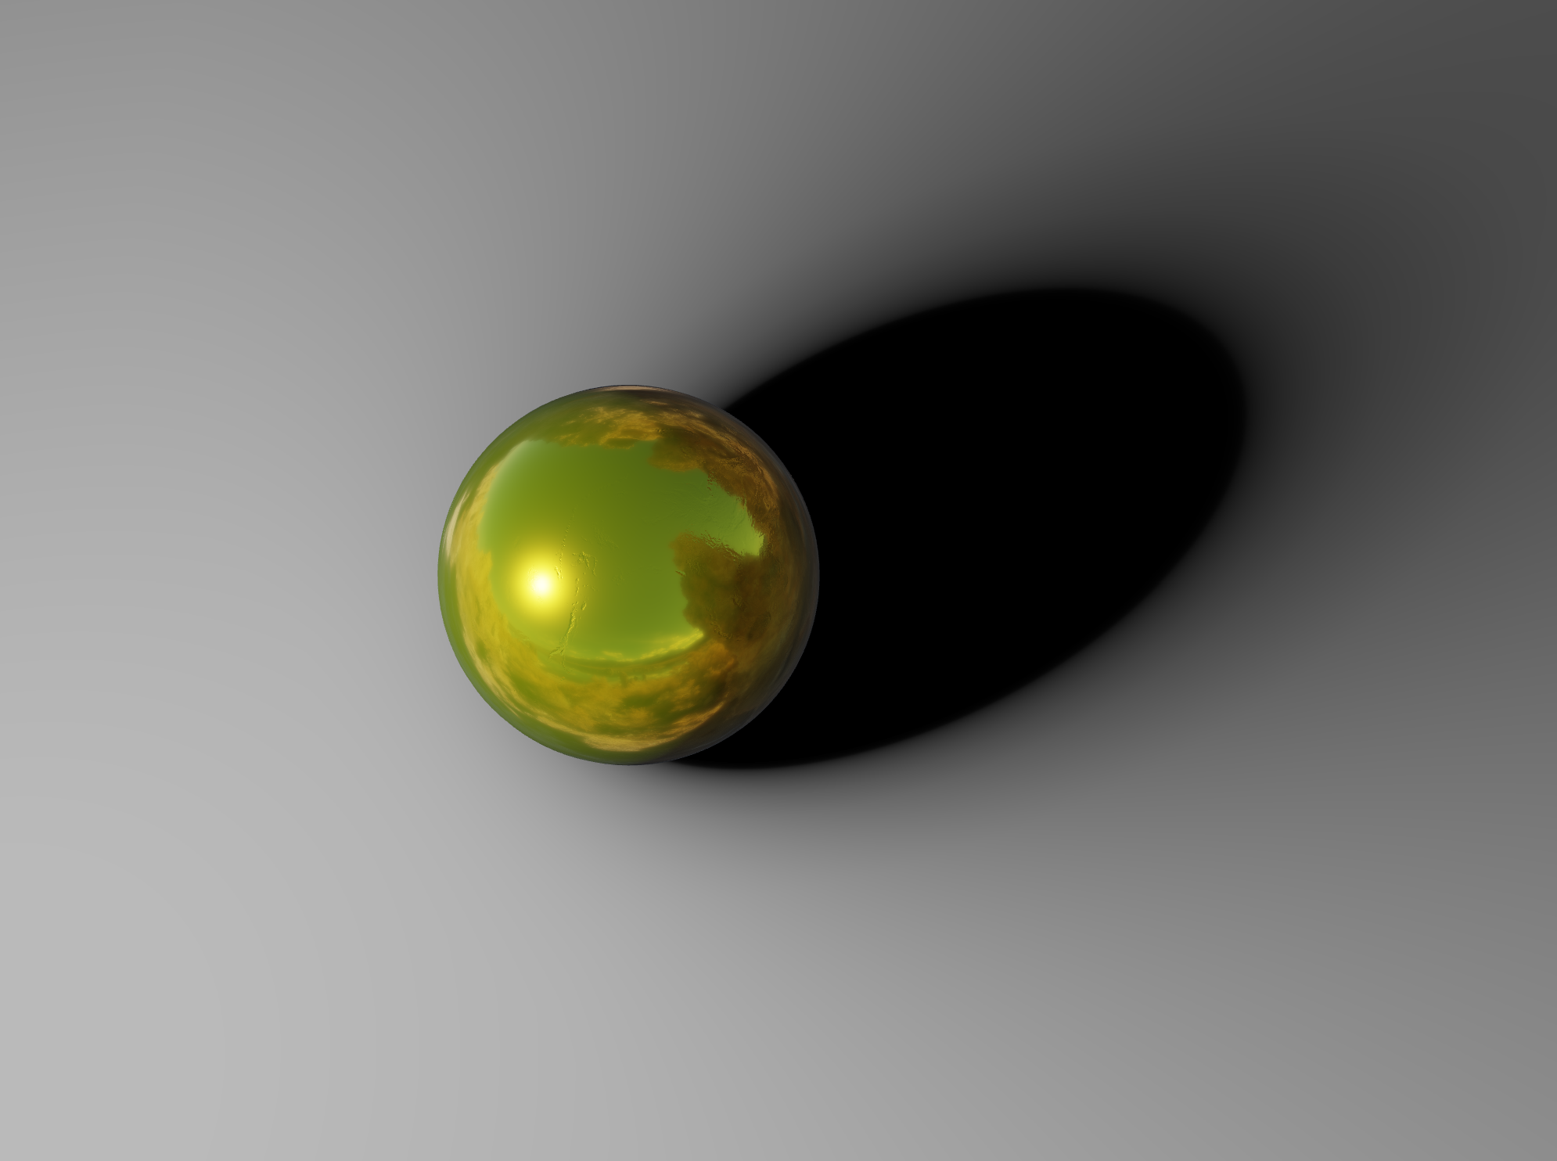
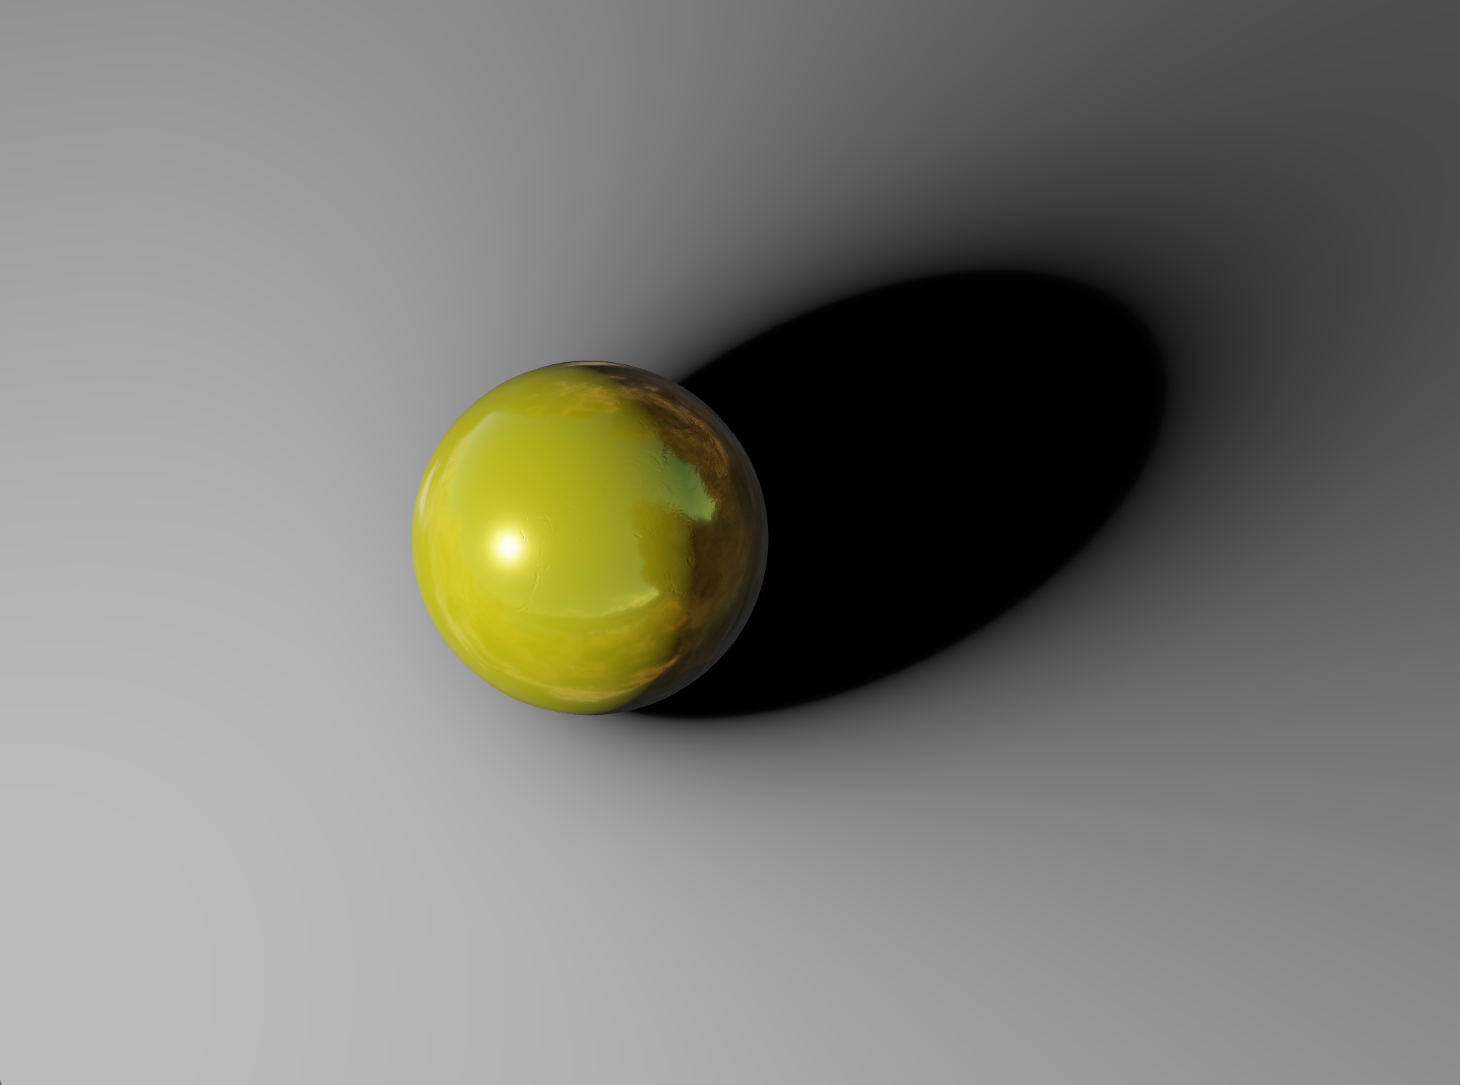


Metallic
Metal Materials have no diffuse reflection, that is, only specular highlights. This is due to the complex refractive index of the metal, and the light will attenuate quickly after entering the metal. So, the scattering part is very small.
Roughness=0.2
How do we describe a surface
Roughness=0.5
Roughness
Metallic=0.8
Metallic=0.5
Suppose all materials’ surfaces are composed of many tiny planes with different orientations. Smoother leads to order, rougher leads to disorder.
To be more specific, roughness describes the probability that the half-angle vector coincides with the normal direction of the microfacet.
Notes:
People used the microfacet surface model in lighting to simulate the object's surface roughness. Also, natural radiation was thought to be needed to describe the energy of light, called energy conserving. The metallic represented the proportion of metal in the material. As you know, metal materials have no diffuse reflection. You can see that those renderings have a great effect.

Slide 5
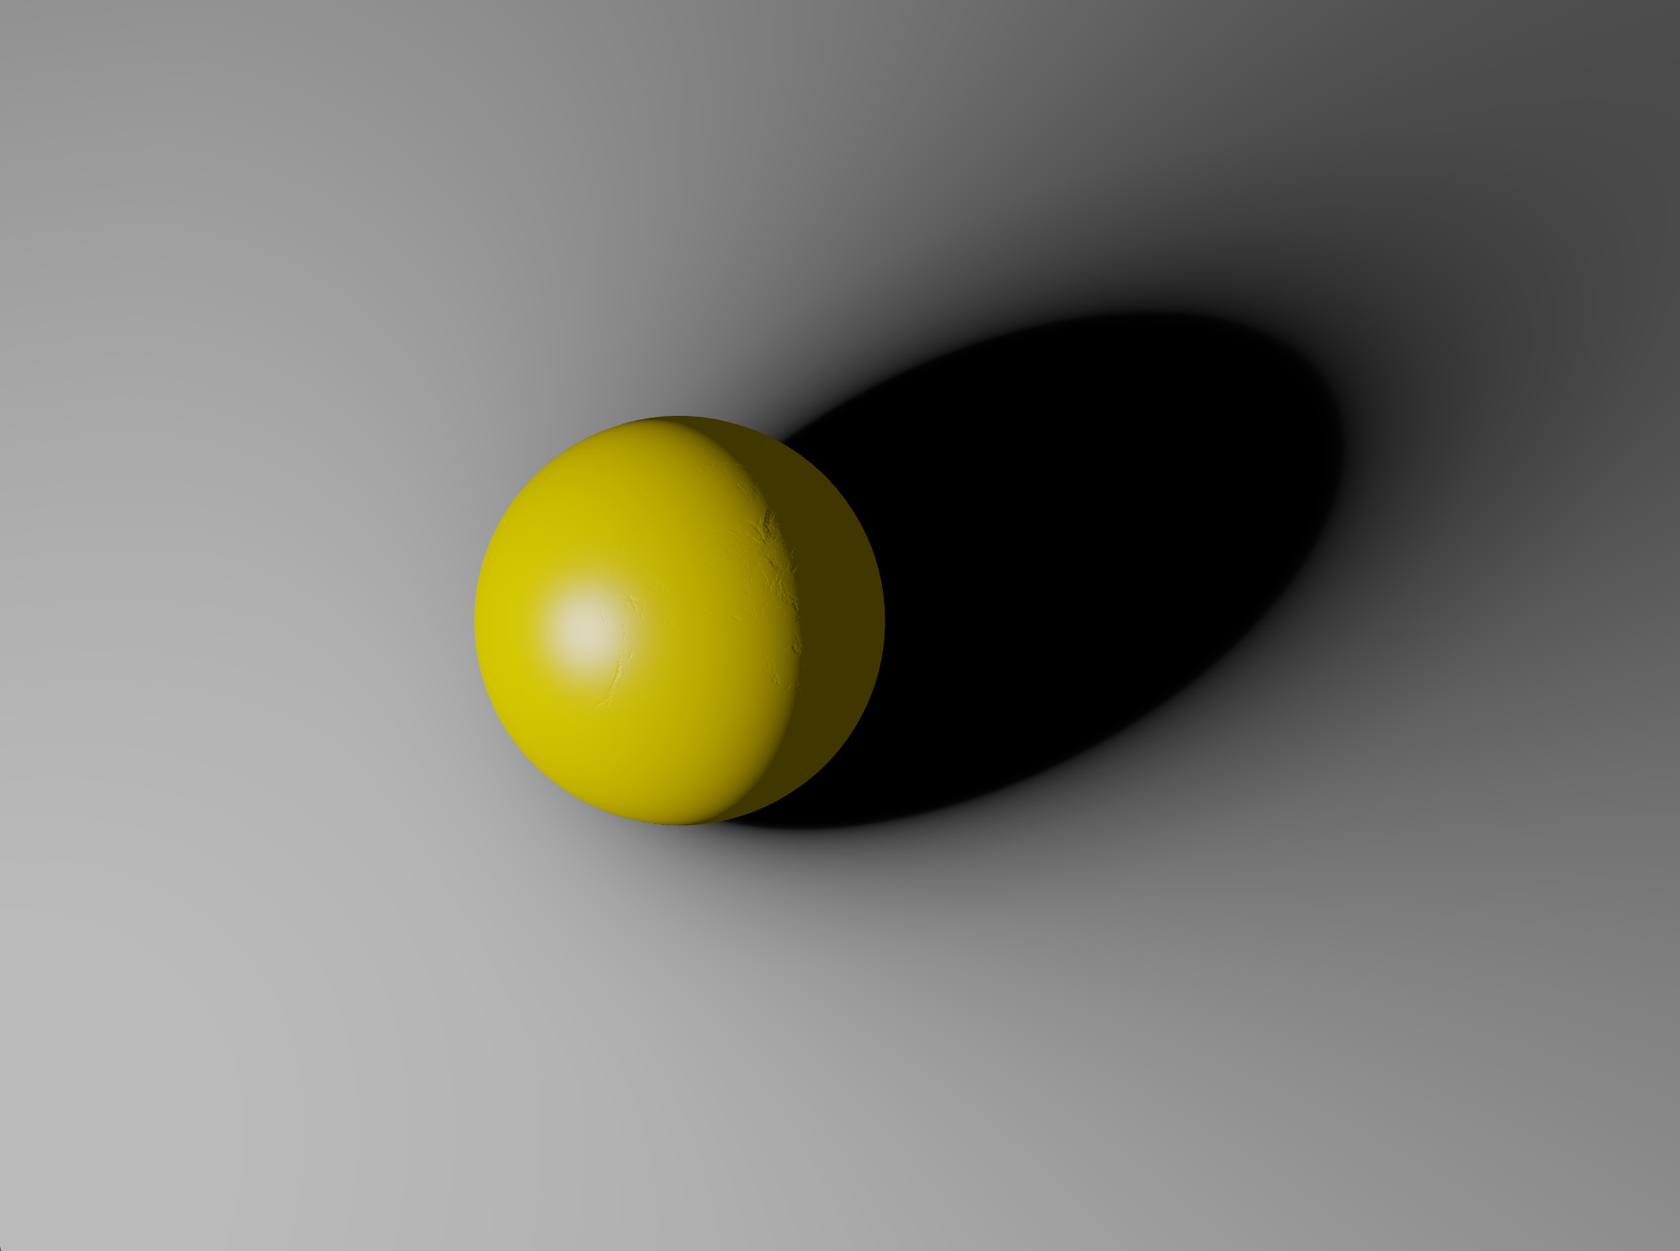
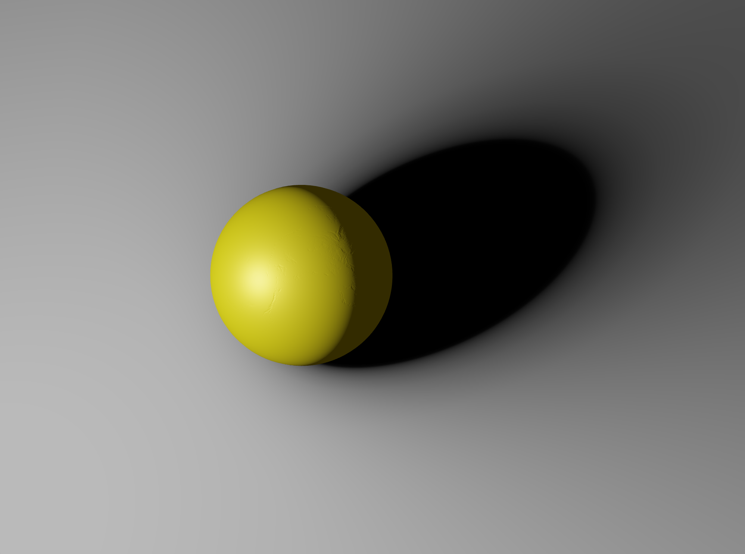
Compare
Under single-light rendering
There is not a big gap
Between Phong and PBR
Phong Lighting Model
PBR
Phong is much simpler than PBR, so why people use PBR?
Notes:
Here are some comparisons between Phong and PBR. Why do people prefer to use PBR nowadays? An essential reason is that TA, the technical artist, won't need to tune parameters! They can directly use real-world parameters and quickly get amazing pictures!

Slide 6
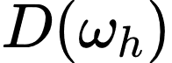
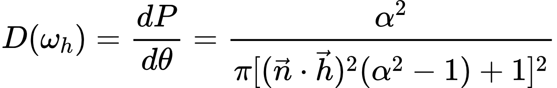
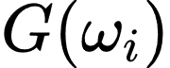
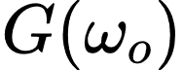
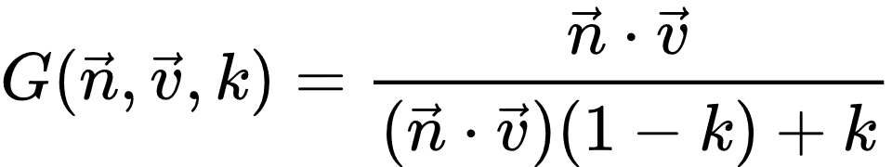

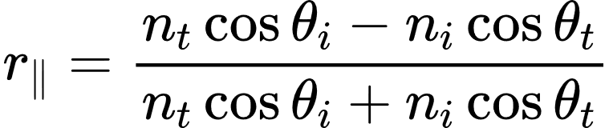
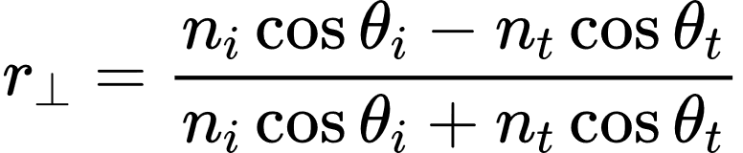
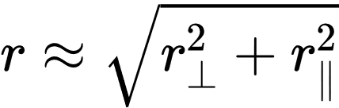
Complete Formula
Lighting Equation
$ω_{i}$ is the unit vector of the incident direction
$ω_{o}$ is the unit vector of the reflection direction
Normal Distribution Function
Geometry Function and
Heavy Math!!!
is calculated by roughness
Approximation of Fresnel’s Formula
In physics, Fresnel's formula describes the reflectance of ideal specular reflection of light at the interface of a medium.
We can derive the Fresnel formula through the boundary value relation of the electromagnetic field:
Schilick approximation of Fresnel's formula:
Notes:
Here are some formula derivations, but we won't discuss the details. We only need to calculate this integration. In 2003, an epoch-making paper was published. They were using Spherical Harmonics to estimate this integration. In recent years, thanks to the rapid development of GPU, Unreal Engine 4 gives another approximation. This method is high-speed, and the photos shown before result from our reproduction.

Slide 7
Shadow
3
Traditional Shadow Techniques
Shadow Map and PCF(Percentage-Closer Filter)
PART
Soft Shadow
Based on PCF, people proposed PCSS and VSSM
New technique: SDFSS(Signed Distance Filed Soft Shadow)
Notes:
The second thing we want to share is shadow. The traditional shadow technique was shadow map. It has many bugs, like shadow acne, peter panning, and it too slow needs over-sampling to improve quality. Also, it doesn't create a soft shadow! Recall your life experiences. All the shadows you have seen are soft! People improved it by using Percentage-Closer Soft Shadow (Based on PCF) and Variance Soft Shadow Mapping (Faster PCSS).

Slide 8
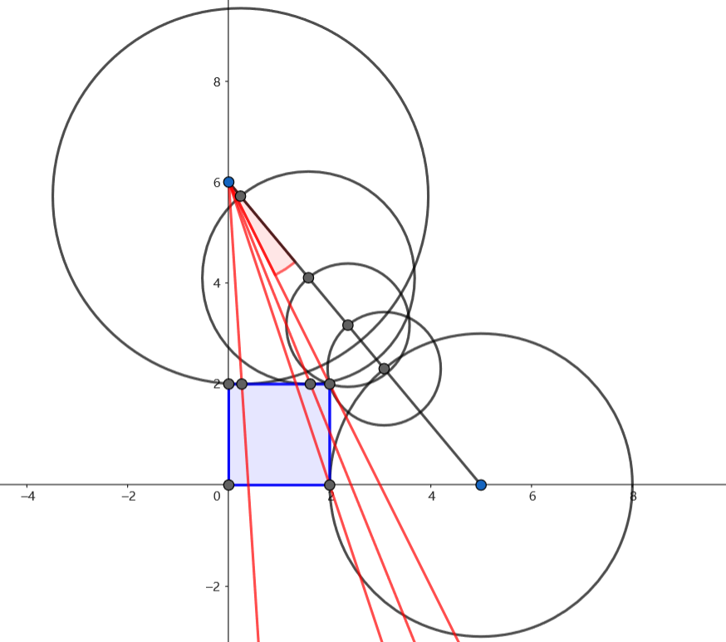
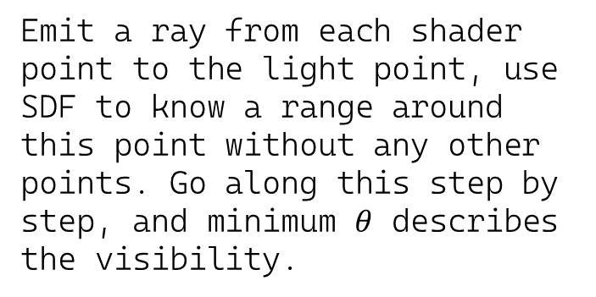
Emit a ray from each shader point to the light point, use SDF to know a range around this point without any other points. Go along this step by step, and minimum $θ$ describes the visibility.
Signed Distance Field Soft Shadow
But it’s too difficult to reproduce !!!
Notes:
Nowadays, a new technique has become popular. It is called Signed Distance Field Soft Shadow. We start from each shader point, emit a ray to the light point, and go through this step by step. The SDF can tell us there cannot be any occlusion inside these circles. So, an intuitive way is that the smallest theta describes the visibility of this shader point. But it is too difficult to reproduce! Many details were not shared with the public, and we can't read the source code of UE4. But we tried our best to do it.

Slide 9

Correct Signed Distance Field Soft Shadow
Signed Distance Field Soft Shadow
Notes:
This photo should be the correct one.

Slide 10
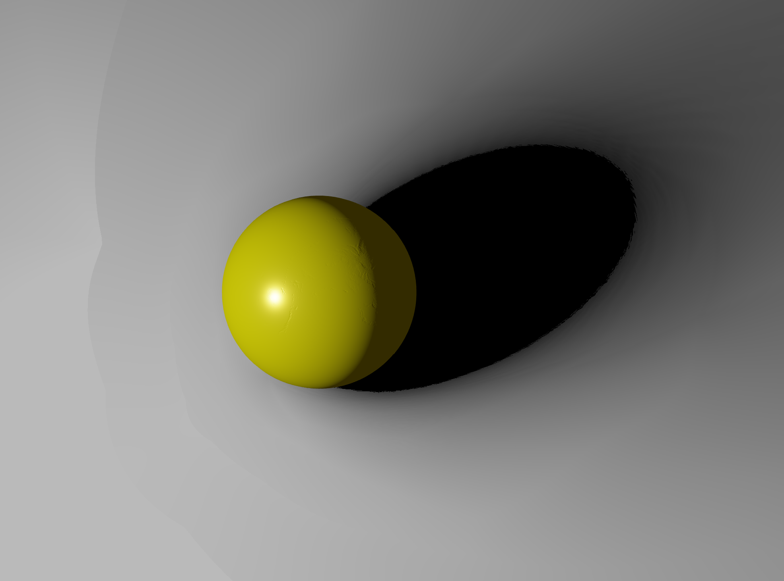
Without Draw Sphere on Light Position
Signed Distance Field Soft Shadow
Notes:
One is that we also need to draw a sphere at the light point. More than just on the path is required. Otherwise, you can see this.

Slide 11

Use Some Approximation to Generate SDF
We generate a cube SDF which is slightly larger than object, since the object is much smaller than whole scenes. Then, when we need to query any point on the scene, we use the smallest distance between this point to the cube plus the preprocessed SDF distance of the intersection point of such shortest distance.
Signed Distance Field Soft Shadow
Notes:
Another thing is that the generation of the Signed Distance Field is tricky. Just a 64 times 64 times 64 pixels SDF is already very huge. But if we use some approximation, you can see this.

Slide 12

Why don’t use vector to describe distance?
It could interpolate better when we query distance
Floating point precision is not important
So, we can compress the vector to a float to achieve the same memory consumption
Question
When we generate the SDF, we actually already know this vector and can directly get it
Dramatically decrease incompleteness of the edges
Notes:
Also, why UE won't use vectors to describe distance? In this way, we can interpolate better approximations. Also, this whole method doesn't require much floating-point precision and easily achieves the same memory storage. We also apply this, and you can see a bit of improvement in the left one.

Slide 13
Summary
4
Lighting and Shadows
Explore and reproduce some state-of-art technology
PART
Coding
We wrote everything in OpenGL all by ourselves.
Everything is public on GitHub(at last almost 2000 lines)
https://github.com/LJFYC007/Cosmos
Notes:
So, in our group work, we explored the real-time rendering technique and studied how to render more realistic lighting and shadows. Also, we raised some questions and made a little progress. And we believe that PBR and SDF have great potential for further development under ray tracing. The whole code is written by ourselves using OpenGL. This project is public on GitHub if you are interested.

Slide 14
References
Phong, Bui Tuong. "Illumination for computer generated pictures." Communications of the ACM 18.6 (1975): 311-317.
5
Pharr, Matt, Wenzel Jakob, and Greg Humphreys. Physically Based Rendering: From Theory to Implementation. No. BOOK. Morgan Kaufmann Publishers Inc., 2016.
Schlick, Christophe. "An inexpensive BRDF model for physically‐based rendering." Computer graphics forum. Vol. 13. No. 3. Edinburgh, UK: Blackwell Science Ltd, 1994.
Abramsky, Samson, Radha Jagadeesan, and Pasquale Malacaria. "Full abstraction for PCF." Information and computation 163.2 (2000): 409-470.
PART
Fernando, Randima. "Percentage-closer soft shadows." ACM SIGGRAPH 2005 Sketches. 2005. 35-es.
Daniel Wright.Advances in Real-Time Rendering in Games. Advances in Real-Time Rendering in 3D Graphics and Games. https://advances.realtimerendering.com/s2015/DynamicOcclusionWithSignedDistanceFields.pdf. Accessed 10 December 2022.
Sloan, Peter-Pike, Jan Kautz, and John Snyder. "Precomputed radiance transfer for real-time rendering in dynamic, low-frequency lighting environments." Proceedings of the 29th annual conference on Computer graphics and interactive techniques. 2002.
Notes:
Here are our references.

Slide 15
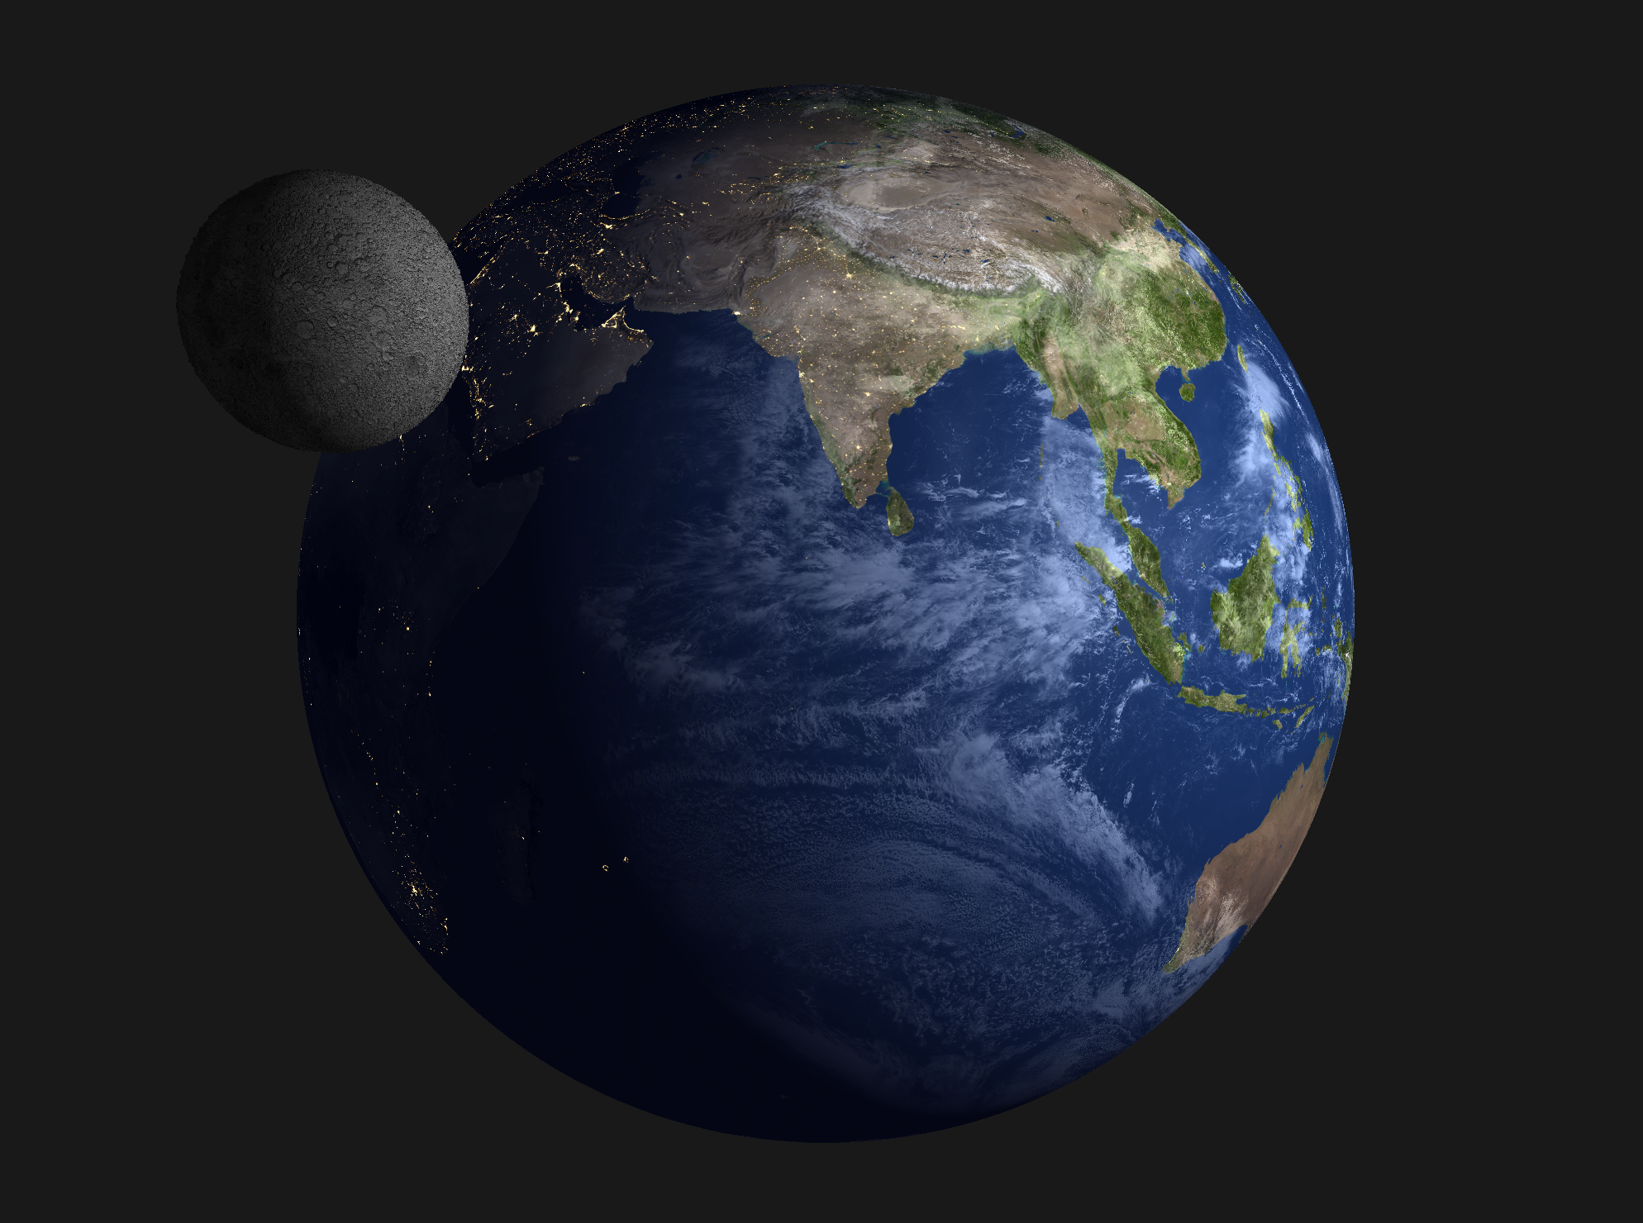
李天宇:Learn and explore how to generate the SDF and write the corresponding code.
任雨奇:Learn and explore the PBR part and lead us to a complete derivation of formulas.
鲁劲帆:Focus on the OpenGL part and try to reproduce those algorithms.
6
And we prepared all relevant matters of this pre together.
PART
We also render the earth and moon by ourselves!
We use some online resources, e.g., day/night texture map, normal map, cloud map, and height map, to generate such a fantastic picture!
Notes:
Also, we want to share a picture rendered by ourselves. Thank you very much
Vertex Shader; Shape Assembly; Geometry Shader; Rasterization; Fragment Shader; Test and Blending
IBL: Image Based Lighting; use some cubemap; contains visibility, lighting and brdf. Some approximation. Environment global lighting
SDF: 3d texture, size 64, pre-compute each point in it, query any point, use interpolate
PBR: much more accurate, each parameter has physics meaning, a more realistic image, but solving it is difficult, we need approximate it.
A main point is, the integral of f(x) time g(x) is approximately equal to the mean of f(x) times integral of g(x)
SDF: require the object are fixed since we need pre-generate the SDF. Much faster than Shadow map, and much more realistic, although it is not based on physics.
PBR and SDF have great potential for further development under ray tracing. But shadow map I think not.
Shadow map: need to render this scene so many times, depending on the number of lights.
Shadow Acne: some obvious black lines in an alternating fashion
Peter panning: some visible offset
Incident light, reflective light, degrees of freedom

